Slide 1
App architecture without RDBS vs NoSQL drama
Jeff Putz

Slide 2
About me
Working the softwares since 1999-ish.
Diverse experience, from megacorps like Microsoft and Humana to startups and dot-com flameouts.
Currently VP of Product Development and Software Engineering for novi AMS.
Been hiring people on and off for the last ten years.
Decks: https://github.com/jeffputz
jeff@popw.com and on the Twitter @jeffputz

Slide 3
Who is this for
Developers, developers, developers
“Architects”
Skeptical business folk
This is not an argument about scalability, but rather choosing the right tool (scale is different for SQL vs. NoSQL)

Slide 4
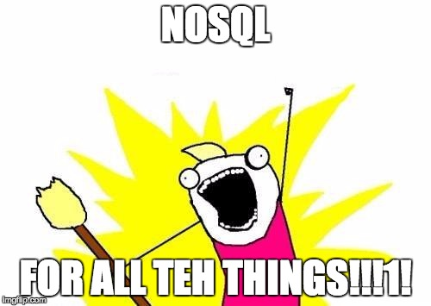
2010

Slide 5
To SQL or not to SQL
Does your data have relationships? Parent/child relationships are the biggest reason for this. Use SQL.
Have unstructured data, data retrieved by a single key, documents, blobs? Use NoSQL.
Does your schema change a lot, is querying reasonably specific and are do you have specific throughput targets? NoSQL, but get ready to research your options.
What experience does your team have? SQL is cheaper to support because everyone knows it. Also: SQL can probably do what you need.

Slide 6
What problems does NoSQL solve?
Computationally less expensive, depending on which system.
Crazy throughput, especially for writes, also depending on system.
Tons of options, many in managed cloud offerings.
Many are open source, so licensing is not a component of cost.
Simple API’s, usually RESTful, so they’re platform agnostic (though let’s be honest, you can use SQL variants everywhere too).
Using NoSQL and thinking in the simplest terms is good practice for better SQL.

Slide 7


Slide 8
A quick reality check
You are not Facebook or the Twitter.

Slide 9
The new normal
Most SQL databases can do straight, single-key storage adequately.
Fight the urge to normalize everything.
Sometimes, it’s OK to compose instead of join (an important consideration for NoSQL usage, but also for SQL).
Important: Don’t build schema around object graphs that never have to be interrogated. Just serialize it, drop it in a single field.
Break down what your business need is, and figure out the fastest possible way to get it. Focus on the domain, not the persistence and code mechanisms.

Slide 10
“Normal” thinking
BAD:
Parent table with object definition and metadata
Child tables: Key value pairs
More tables: Actual data referencing the child tables
GOOD:
One table, rows for definition, metadata and serialized data blob

Slide 11
SQL sauce: Avoid the join
Aggregate querying is the performance bottleneck sin for the average LOB app. Multiple joins plus averages or sums are bad news.
Think about what physically has to be read from a disk to generate your results.
Create well-defined logic pipelines in your app (not the database!) that recalculate aggregate fields when the relevant data changes, so you don’t have to query it in real time.
One calculation when the data changes in faster than calculating all of it every time!

Slide 12
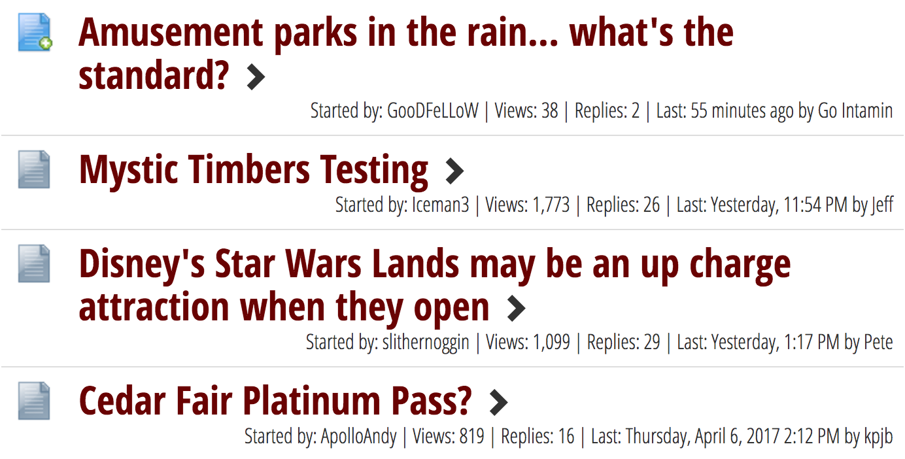

Slide 13
Beautifully cloudy days
Azure, AWS, Google have countless options.
SQL Server in the cloud > on-premise SQL (don’t let DBA’s tell you otherwise).
Instrumentation on cloud services is generally excellent (some even make suggestions to better your schema or indexing).
Maintenance and administration is near zero.
Pricing models vary based on a combination of storage and transactional throughput.

Slide 14
Questions
Decks: https://github.com/jeffputz
jeff@popw.com and on the Twitter @jeffputz

